Slide 1
Model Packaging
Pravin Y Pawar
Adapted from “Engineering MLOps”
By Emmanuel Raj

Slide 2
Model Packaging
The process of exporting the final ML model into a specific format
e.g. PMML, PFA, or ONNX,
which describes the model to be consumed by the business application

Slide 3
Why package ML models?
MLOps enables a systematic approach to train and evaluate models
After models are trained and evaluated, the next steps are to bring them to production
ML doesn't work like traditional software engineering, which is deterministic in nature
where a piece of code or module is imported into the existing system and it works
Engineering ML solutions is non-deterministic involves serving ML models to make predictions or analyze data
To serve the models, they need to be packed into software artifacts
to be shipped to the testing or production environments
are packaged into a file or a bunch of files or containers
ML models need to be packaged for the following reasons:
Portability
Inference
Interoperability
Deployment agnosticity

Slide 4
Why package ML models?(2)
Portability and Inference
Portability
Packaging ML models into software artifacts enables them to be shipped or transported from one environment to another
can be done by shipping a file or bunch of files or a container
can transport the artifacts and replicate the model in various setups
For example, a packaged model can be deployed in a virtual machine or serverless setup
Inference
Enables to serve the ML models in real time for ML inference
ML inference - process that involves processing real-time data using ML models to calculate an output,
for example, a prediction or numerical score
Effective ML model packaging - a serialized model or container - facilitate
deployment and serve the model to make predictions
analyze data in real time or in batches

Slide 5
Why package ML models?(3)
Interoperability and Deployment agnosticity
Interoperability
ability of two or more models or components to exchange information and to use exchanged information
in order to learn or fine-tune from each other and perform operations with efficiency
Exchanged information can be in the form of data or software artifacts or model parameters
enables models to fine-tune, retrain, or adapt to various environments
Packaging ML models is the foundation for enabling ML model interoperability
Deployment agnosticity
Packaging ML models into software artifacts such as serialized files or containers
enables the models to be shipped and deployed in various runtime environments, such as in
a virtual machine,
a container serverless environment,
a streaming service,
microservices,
or batch services
Opens opportunities for portability and deployment agnosticity using the same software artifacts that an ML model is packaged in

Slide 6
How to package ML models?
ML models can be packaged in various ways
depending on business and tech requirements
and as per operations for ML
ML models can be packaged and shipped in three ways
Serialized files
Packetizing or containerizing
Microservice generation and deployment
Deployment Strategies
Common ways for wrapping trained models as deployable services, namely deploying ML models
as Docker Containers to Cloud Instances
as Serverless Functions

Slide 7
How to package ML models?(2)
Serialized files
Serialization is a vital process for packaging an ML model
enables model portability, interoperability, and model inference
Serialization is the method of converting an object or a data structure (for example, variables, arrays, and tuples)
into a storable artefact, for example, into a file or a memory buffer
that can be transported or transmitted (across computer networks)
only saves the data structure as it is in a storable artefact such as a file
The main purpose of serialization is to reconstruct the serialized file into its previous data structure in a different environment
for example, a serialized file into an ML model variable
A newly trained ML model can be
serialized into a file
exported into a new environment
can de-serialized back into an ML model variable or data structure for ML inferencing

Slide 8
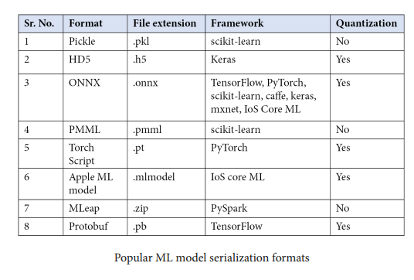
How to package ML models?(3)
Serialized files Formats

Slide 9
How to package ML models?(4)
Packetizing or containerizing
Every environment possesses different challenges when it comes to deploying ML models,
in terms of compatibility, robustness, and scalability
can be avoided by standardizing some processes or modules
containers are a great way to standardize ML models and software modules
A container is a standard unit of software made up of code and all its dependencies
enables the quick and reliable operation of applications from one computing environment to another
enables the software to be environment- and deployment-agnostic
managed and orchestrated by Docker
Docker - industry standard at developing and orchestrating containers
developed to make it convenient to build, deploy, and run applications by using containers

Slide 10
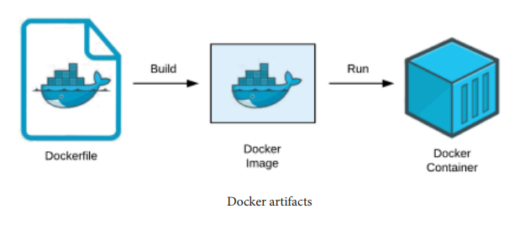
How to package ML models?(5)
Docker
By using containers, a developer can package an application with its components and modules,
such as files, libraries, and other dependencies, and deploy it as one package
Docker containers are built using Dockerfiles, which are used to containerize an application
After building a Docker image, a Docker container is built
A Docker container is an application running with custom settings as orchestrated by the developer
A Dockerfile is built into a Docker image, which is then run as a Docker container

Slide 11
How to package ML models?(6)
Docker and ML Models
Foundational components for building and running containers
A Dockerfile, Docker image, and a Docker container
Dockerfile:
a text document containing a set of Docker commands ordered by the developer to build a Docker image
Docker is able to read the Dockerfile and build a Docker image
Docker image:
a sequential collection of execution parameters to use within a collection of root filesystems within a container during runtime
Docker images are like a snapshot of containers
Containers are constructed from Docker images
Docker container:
Containers are constructed from Docker images
A container is a runtime instance of a Docker image
ML models can be served in Docker containers for robustness, scalability, and deployment agnosticity

Slide 12
How to package ML models?(7)
Microservices
Microservices enable the collection of services that are independently deployable
Each of these services is highly maintainable, testable, and loosely coupled
are orchestrated by architecture that is organized around business capabilities to enable a system to serve business needs
Fragmented microservices are now developed by a dedicated team
Each microservice is isolated and less dependent on one another
easier to develop and maintain

Slide 13
How to package ML models?(9)
Microservices: Construction
Typically, a microservice is generated by tailoring serialized files into a containerized Docker image
Docker images can then be deployed and orchestrated into any Docker - supported environment
Deploying and managing Docker images can be performed using container management tools
such as Kubernetes
Docker enables extreme portability and interoperability
Docker images can be easily deployed to any popular cloud service,
such as Google Cloud, Azure, or AWS
Docker images can be deployed and managed to any
Docker corporate server or data center or real-time environment as long as it supports Docker.

Slide 14
How to package ML models?(10)
Microservices: Serving
A popular way to serve ML models - Microservices can be served in a REST API format
Python frameworks, such as Flask, Django, and FastAPI
Popular in enabling ML models to serve as REST API microservices
Kubeflow - is a robust way of serving a models on scale
cloud-agnostic and can be run on-premises or on local machines
based on Kubernetes, but keeps the Kubernetes details and difficulties inside a box
To facilitate robust and scalable system operations, software developers can sync with Dockerized microservices via a REST API

Slide 15
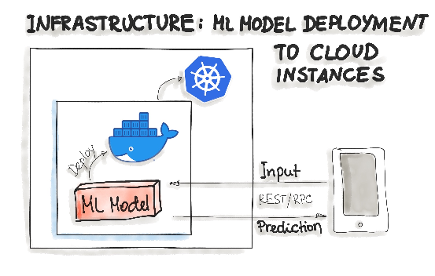
Deploying ML Models as Docker Containers
As of now, there is no standard, open solution to ML model deployment!
ML model inference being considered stateless, lightweight, and idempotent,
containerization becomes the de-facto standard for delivery
means deploy a container that wraps an ML model inference code
For on-premise, cloud, or hybrid deployments, Docker is considered to be de-facto standard containerization technology
One ubiquitous way is to package the whole ML tech stack (dependencies) and the code for ML model prediction into a Docker container
Then Kubernetes or an alternative (e.g. AWS Fargate) does the orchestration
The ML model functionality, such as prediction, is then available through a REST API (e.g. implemented as Flask application)
three-levels-of-ml-software

Slide 16
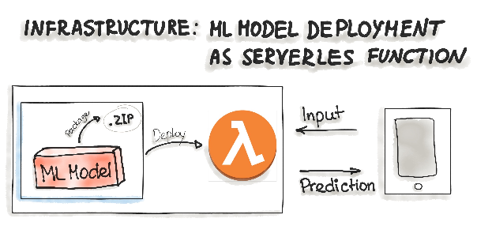
Deploying ML Models as Serverless Functions
Various cloud vendors already provide machine-learning platforms where can deploy model with their services
Amazon AWS Sagemaker,
Google Cloud AI Platform,
Azure Machine Learning Studio,
IBM Watson Machine Learning
Commercial cloud services also provide containerization of ML models
AWS Lambda
Google App Engine servlet host
In order to deploy an ML model as a serverless function,
the application code and dependencies are packaged into .zip files, with a single entry point function
function then could be managed by major cloud providers such as Azure Functions, AWS Lambda, or Google Cloud Functions
attention should be paid to possible constraints of the deployed artifacts such as the size of the artifact
three-levels-of-ml-software

Slide 17
Thank You!
In our next session:

